Slide 1


Spatial segregation indices as a measure of religious segregation
Vyborg 1880—1920
Antti Härkönen,
PhD student

Slide 2
Introduction

Slide 3
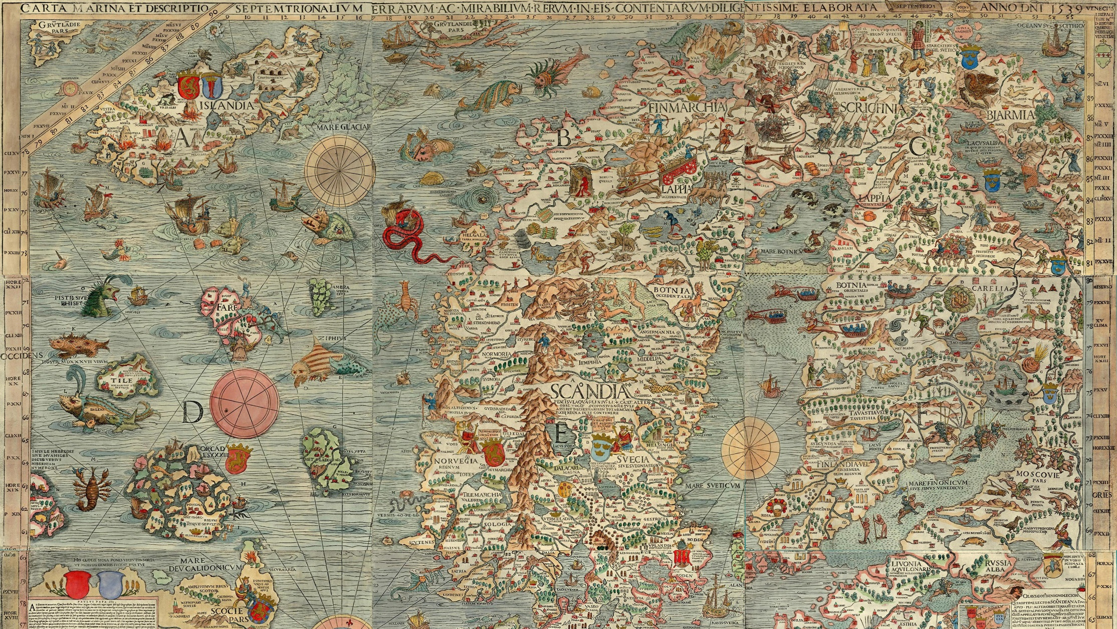

Slide 4
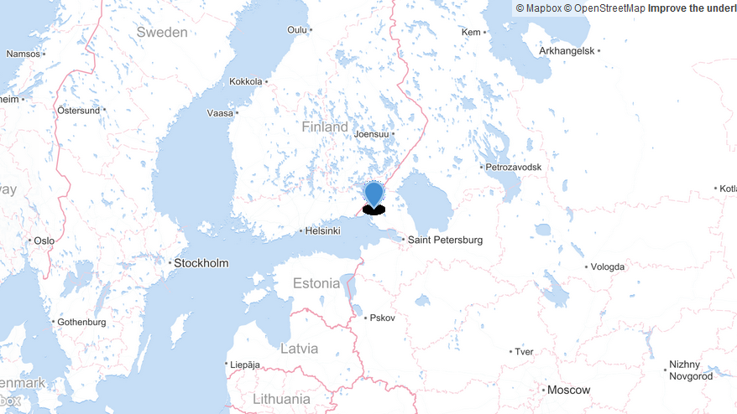

Slide 5
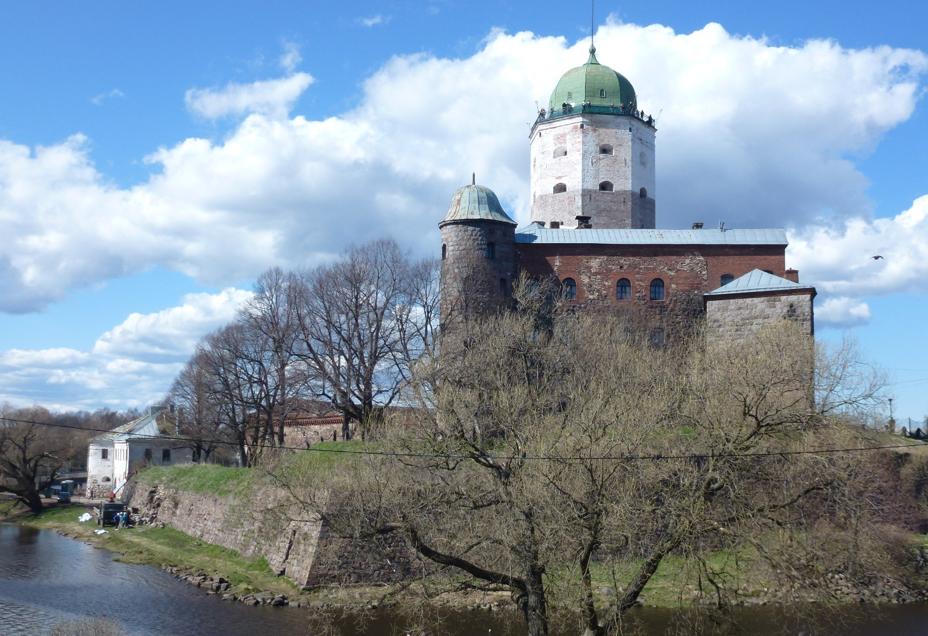
A brief history of Vyborg (1)
Castle founded by Swedes around 1293
Town privileges granted in 1403
Conquered by Russia in 1710
18th century seat of Russian governors

Slide 6
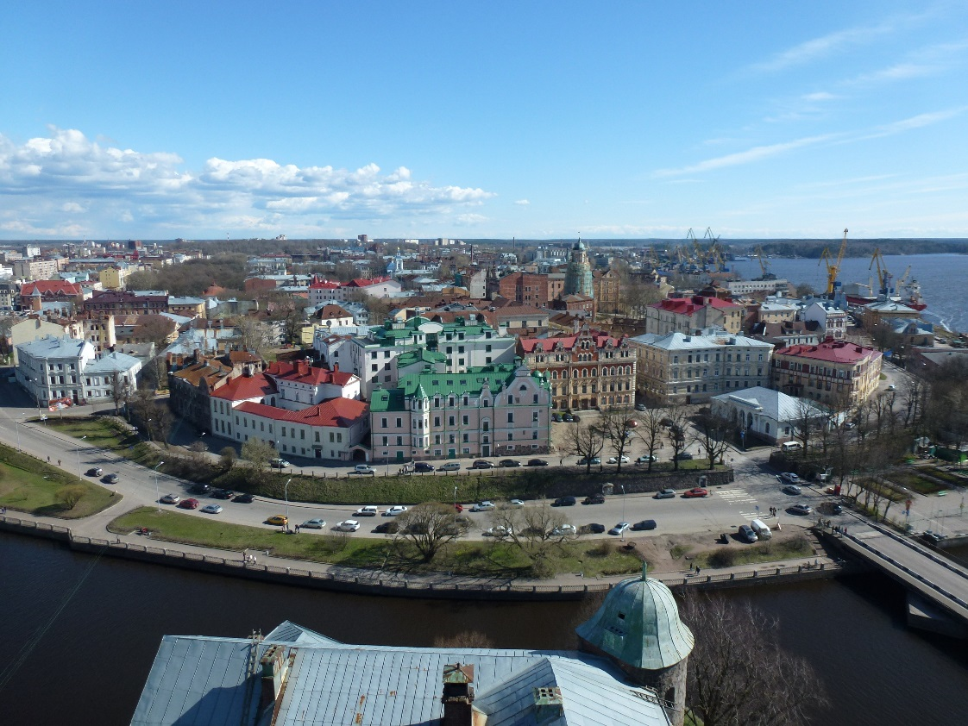
A brief history of Vyborg (2)
Ceded to Autonomous Grand Duchy of Finland (also in Russia since 1809) in 1812
During 1917—1940: the second largest city in the newly independent Republic of Finland
To USSR in 1940 and 1944
Part of Russian Federation

Slide 7
Vyborg was unusually diverse
Lutherans, Russian Orthodox, Roman Catholics, Jews, Muslims
Finnish, Swedish, Russian and German speakers + small minorities

Slide 8
Research question
Was there localised religious segregation in Vyborg in the late 19th and early 20th century?
Lutheran vs Orthodox populations

Slide 9
Sources

Slide 10
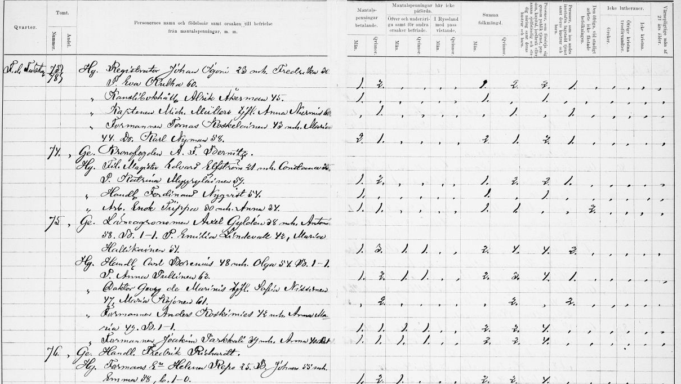

Slide 11
Head tax documents
Three datasets:
1880
1900
1920

Slide 12
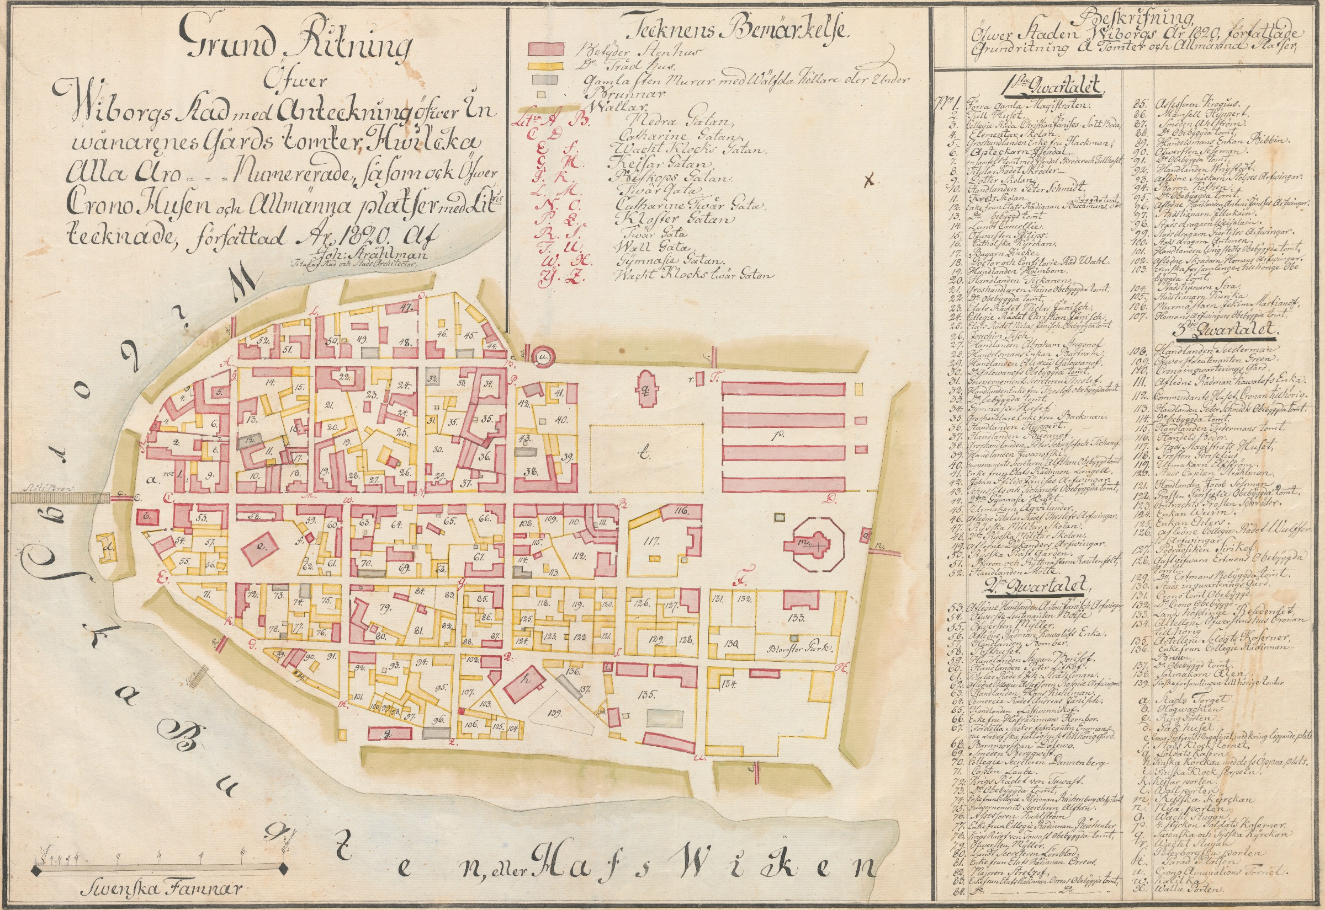

Slide 13
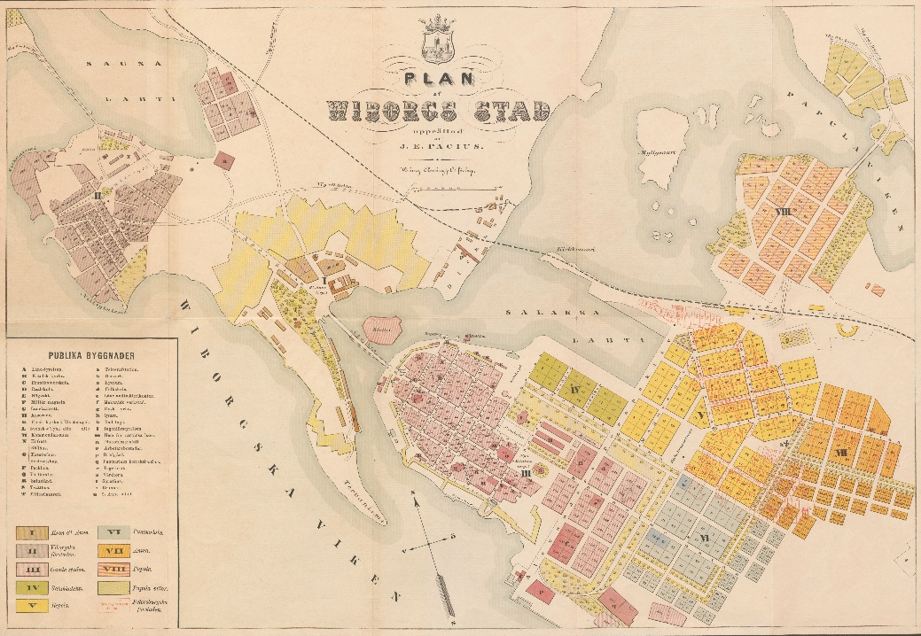

Slide 14
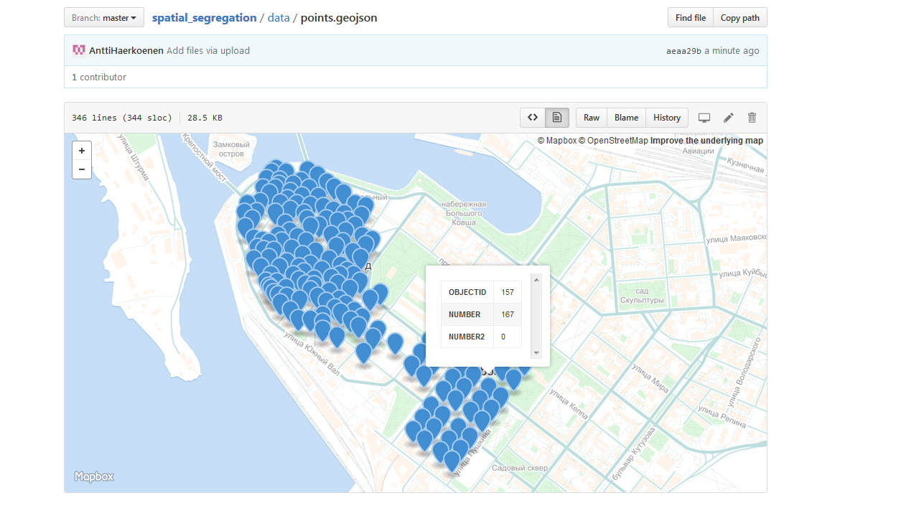

Slide 15
Methods

Slide 16
Segregation indices
Somewhat objective way to compare degrees of segregation across time and space, but…

Slide 17
Requirements for segregation indices
(After Watts 2014)
Scale interpretability
Size invariance, Composition invariance, Areal invariance & Transpose invariance
Symmetry areas & Symmetry groups
Areal equivalence
Transfers
Exchanges
Strong areal decomposability & Strong group decomposability
Local decomposabality

Slide 18
Spatial segregation indices
Like segregation indices, but spatial!
Ecological fallacy
MAUP (Modifiable Areal Unit Problem)

Slide 19
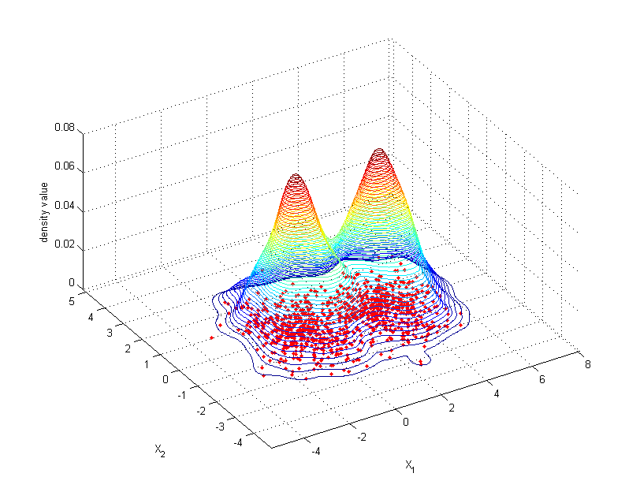
Kernel density estimation (KDE)
Estimated surface instead of areal units

Slide 20

Code
Python 3.5
Modules used:
Shapely – GIS operations
Numpy – arrays for storing data
Pandas – data frames for storing data
Matplotlib – visualisation
All code is available at https://github.com/AnttiHaerkoenen/spatial_segregation.

Slide 21
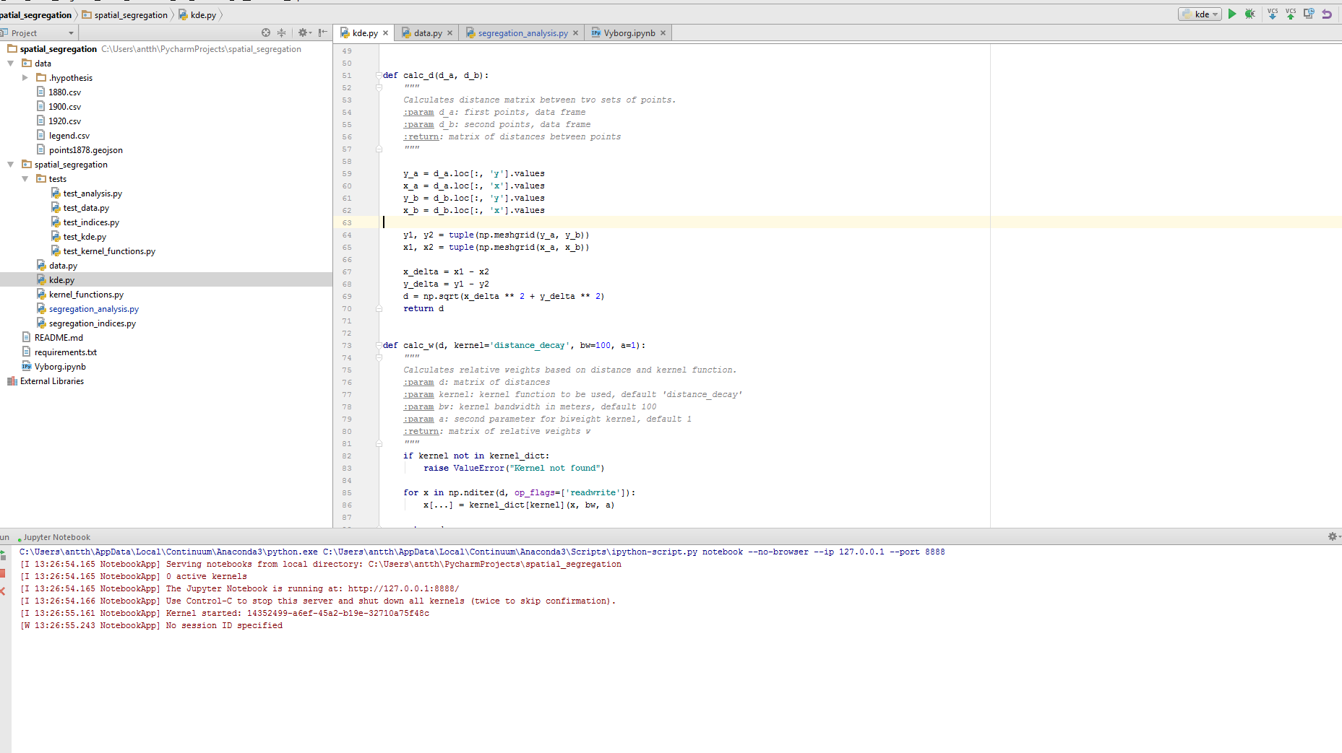

Slide 22
Variety of indices with variety of parameters
Spatial Karmel-MacLachlan index implemented

Slide 23
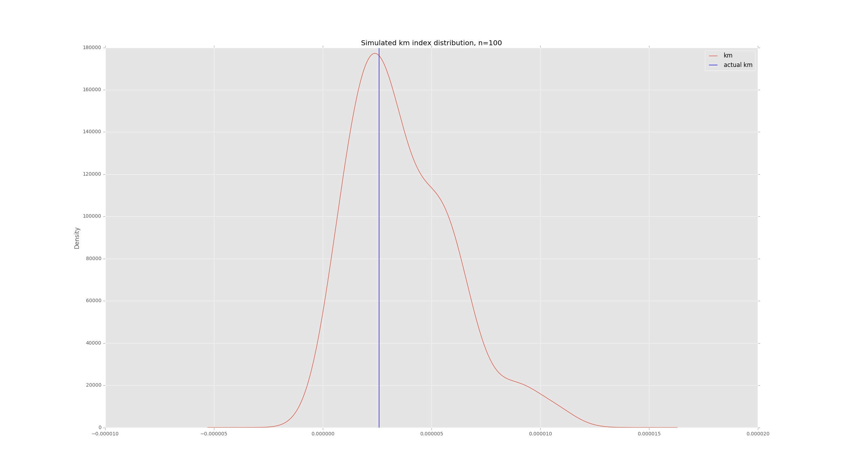

Slide 24
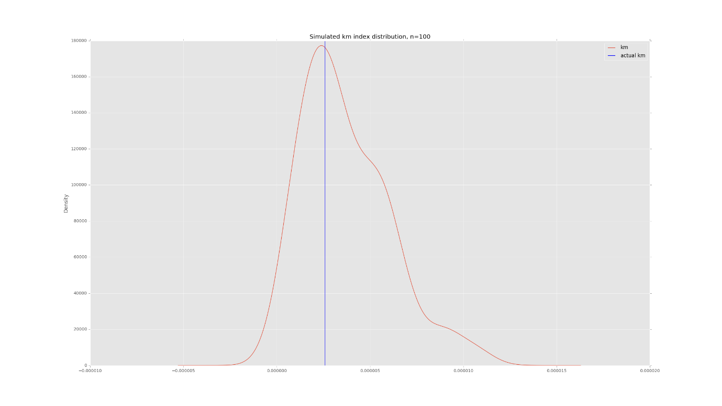
Conclusion
MAUP-FREE Segregation analysis with Kernel density estimation
Statistical significance with Simulations
antti.harkonen@uef.fi

Slide 25
Bibliography[”segregation_analysis”]
Feitosa, F. F.; Câmara, G.; Monteiro, A. M. V.; Koschitzki, T. & Silva, M. P. S. (2007). Global and local spatial indices of urban segregation. International Journal of Geographical Information Science 21(3), 299—323.
Lee, Barrett A.; Reardon, Sean F.; Firebaugh, Glenn; Farrell, Chad R.; Matthews, Stephen A. & O’Sullivan, David (2008). Beyond the Census Tract: Patterns and Determinants of Racial Segregation at Multiple Geographical Scales. American Sociological Review 73, 766—791.
O’Sullivan, David & Wong, David W. S. (2007). A Surface-Based Approach to Measuring Spatial Segregation. Geographical Analysis 39, 147—168.
Watts, Martin (2014). Spatial indexes: a focus on segregation. In Handbook of Research Methods and Applications in Spatially Integrated Social Science, ed. by Robert J. Stimson, Edward Elgar, Cheltenham, UK, 287—314.

Slide 26
Bibliography[”software”]
Gillies, Sean et al. (2007). Shapely: manipulation and analysis of geometric objects. https://github.com/Toblerity/Shapely.
Hunter (2007): Matplotlib: A 2D graphics environment. Computing in Science & Engineering 9(3), 90—95, DOI: 10.1109/MCSE.2007.55
McKinney, Wes (2010). Data Structures for Statistical Computing in Python, Proceedings of the 9th Python in Science Conference, 51-56.
van der Walt, Stéfan; Colbert, S. Chris & Varoquaux, Gaël (2011). The NumPy Array: A Structure for Efficient Numerical Computation, Computing in Science & Engineering, 13, 22-30, DOI:10.1109/MCSE.2011.37
van Rossum, Guido (1995): Python tutorial, Technical Report CS-R9526, Centrum voor Wiskunde en Informatica (CWI), Amsterdam, May 1995

